Slide 1
Lecture Sampling Distribution

Slide 2
Population and sample
The target of an investigation, can be divided into population and sample.
Sample
Population

Slide 3
Population distribution
Population Distribution
The population distribution is the probability distribution of the population data.

Slide 4
Population distribution
Suppose there are five students in an advanced statistics class and the midterm scores of these five students are
70 78 80 80 95
Let x denotes the score of a student. Construct a frequency distribution table and probability distribution table for the population:

Slide 5
Population distribution
70 78 80 80 95
Let x denotes the score of a student. Construct a frequency distribution table and probability distribution table for the population:
x | f | Relative Frequency
70 | 1 | 1/5=0.20
78 | 1 | 0.20
80 | 2 | 0.40
95 | 1 | 0.20
 | N =5 | Sum = 1.00
Population frequency and Relative frequency Distribution

Slide 6
Population distribution
70 78 80 80 95
Let x denotes the score of a student. Construct a frequency distribution table and probability distribution table for the population:
x | P (x)
70 | 0.20
78 | 0.20
80 | 0.40
95 | 0.20
 | ∑ P(x) = 1.00
Population Probability Distribution

Slide 7
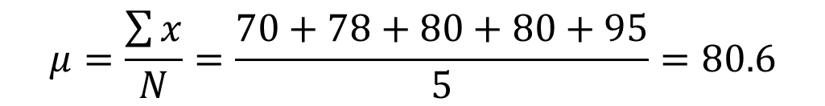
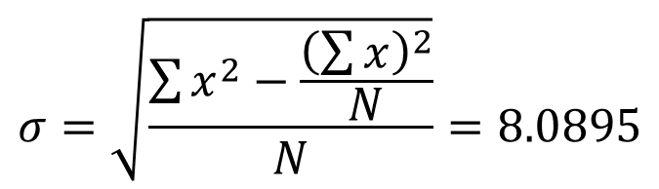
Developing a Sampling Distribution
Summary Measures for the Population Distribution:
$$μ=\frac{\sum{x}}{N}=\frac{70+78+80+80+95}{5}=80.6$$
$$σ=\sqrt{\frac{\sum{x^{2}}−\frac{{\left(\sum{x}\right)}^{2}}{N}}{N}}=8.0895$$

Slide 8
Sampling Distribution
Suppose we assign the letters A, B, C, D and E to the scores of all the five students so that
A = 70, B = 78, C = 80, D = 80, E = 95
Consider three students are selected as a sample without replacement from the population.
Then, the 10 possible samples of the three scores each are:
ABC, ABD, ABE, ACD, ACE, ADE, BCD, BCE, BDE, CDE

Slide 9
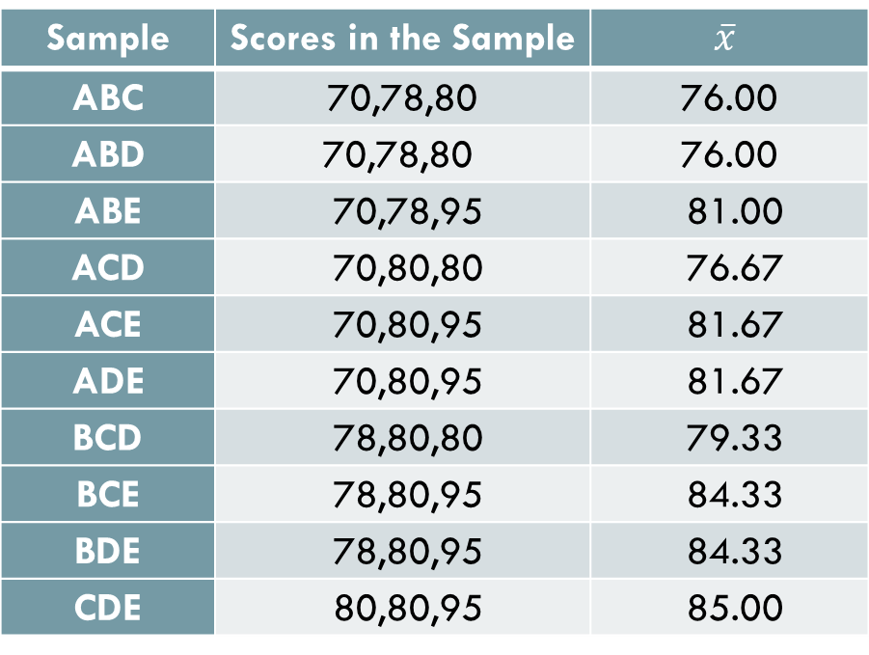
Sampling Distribution
A = 70, B = 78, C = 80, D = 80, E = 95
Sample | Scores in the Sample | $$\overline{x}$$
ABC | 70,78,80 | 76.00
ABD | 70,78,80 | 76.00
ABE | 70,78,95 | 81.00
ACD | 70,80,80 | 76.67
ACE | 70,80,95 | 81.67
ADE | 70,80,95 | 81.67
BCD | 78,80,80 | 79.33
BCE | 78,80,95 | 84.33
BDE | 78,80,95 | 84.33
CDE | 80,80,95 | 85.00
All Possible Samples and Their Means When the Sample size is 3

Slide 10

Sampling Distribution
The probability distribution of $\overline{x}$ is called its sampling distribution. It lists the various values that $\overline{x}$ can assume and the probability of each value of $\overline{x}$. In general, the probability distribution of a sample statistic is called its sampling distribution.

Slide 11
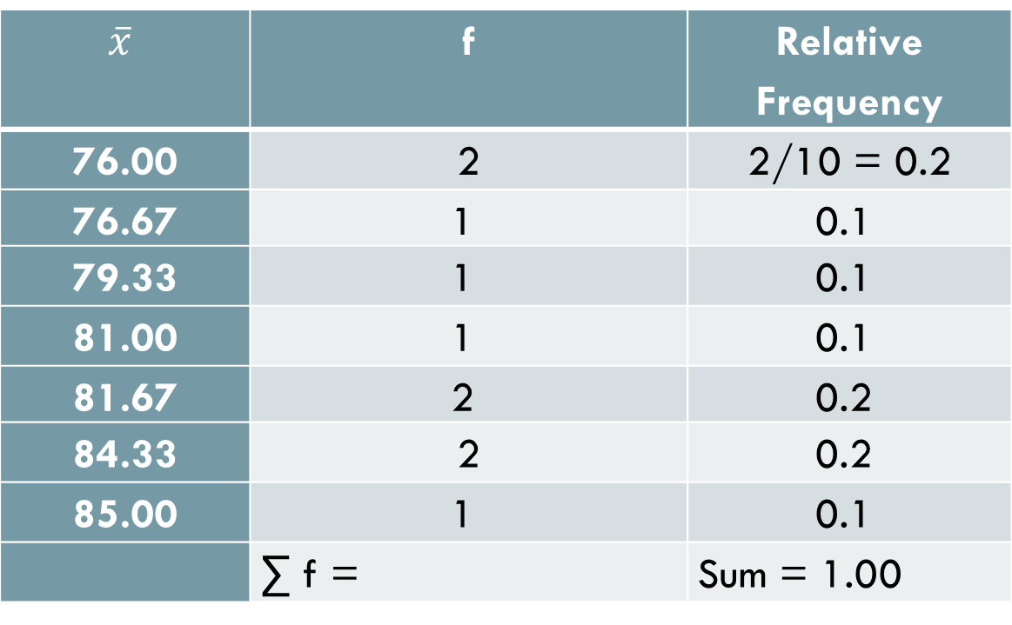
Sampling and sampling distribution
Frequency and Relative Frequency Distribution of $\overline{x}$ when The Sample size is 3
$$\overline{x}$$ | f | Relative Frequency
76.00 | 2 | 2/10 = 0.2
76.67 | 1 | 0.1
79.33 | 1 | 0.1
81.00 | 1 | 0.1
81.67 | 2 | 0.2
84.33 | 2 | 0.2
85.00 | 1 | 0.1
 | ∑ f = | Sum = 1.00

Slide 12
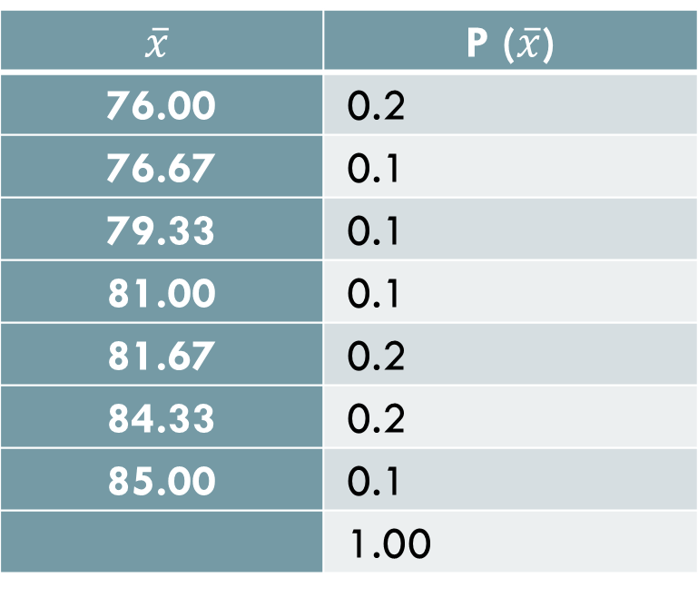


Sampling Distribution
Sampling Distribution of $\overline{x}$ when the Sample size is 3.
$$\overline{x}$$ | P ($\overline{x}$)
76.00 | 0.2
76.67 | 0.1
79.33 | 0.1
81.00 | 0.1
81.67 | 0.2
84.33 | 0.2
85.00 | 0.1
 | 1.00
$μ_{\overline{x}}=$ 80.60

Slide 13
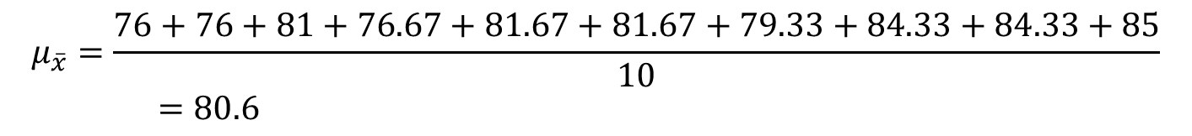
Developing a Sampling Distribution
Summary Measures for the Sampling Distribution:
$$μ_{\overline{x}}=\frac{76+76+81+76.67+81.67+81.67+79.33+84.33+84.33+85}{10}=80.6$$

Slide 14
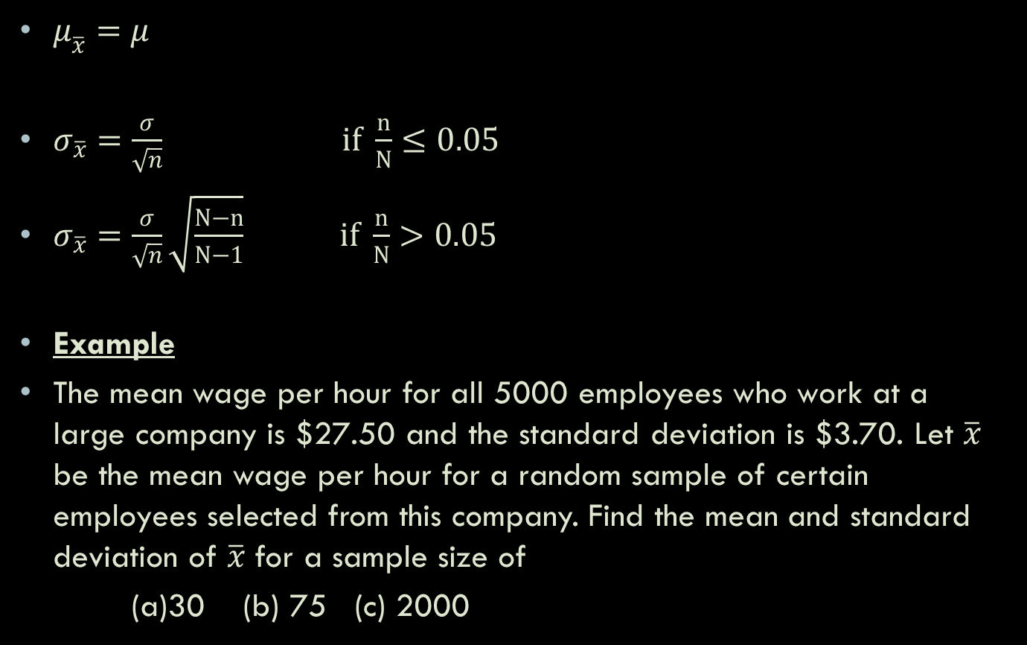
Mean and Standard Deviation of $\overline{x}$
$μ_{\overline{x}}=μ$
$σ_{\overline{x}}=\frac{σ}{\sqrt{n}} if \frac{n}{N}≤0.05$
$σ_{\overline{x}}=\frac{σ}{\sqrt{n}}\sqrt{\frac{N−n}{N−1}} if \frac{n}{N}>0.05$
Example
The mean wage per hour for all 5000 employees who work at a large company is $27.50 and the standard deviation is $3.70. Let $\overline{x}$ be the mean wage per hour for a random sample of certain employees selected from this company. Find the mean and standard deviation of $\overline{x}$ for a sample size of
(a)30 (b) 75 (c) 2000

Slide 15


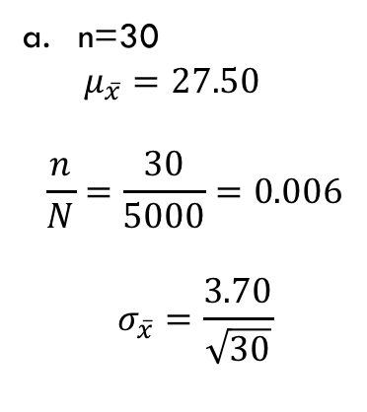

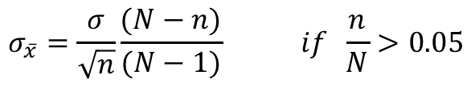
Mean and Standard Deviation
$$μ_{\overline{x}}=μ$$
$$σ_{\overline{x}}=\frac{σ}{\sqrt{n}} if \frac{n}{N}≤0.05$$
$$σ_{\overline{x}}=\frac{σ}{\sqrt{n}}\frac{(N−n)}{(N−1)} if \frac{n}{N}>0.05$$
N=5000 $μ=27.50 σ=3.70$
n=30
$μ_{\overline{x}}=27.50$
$$\frac{n}{N}=\frac{30}{5000}=0.006$$
$$σ_{\overline{x}}=\frac{3.70}{\sqrt{30}}$$

Slide 16
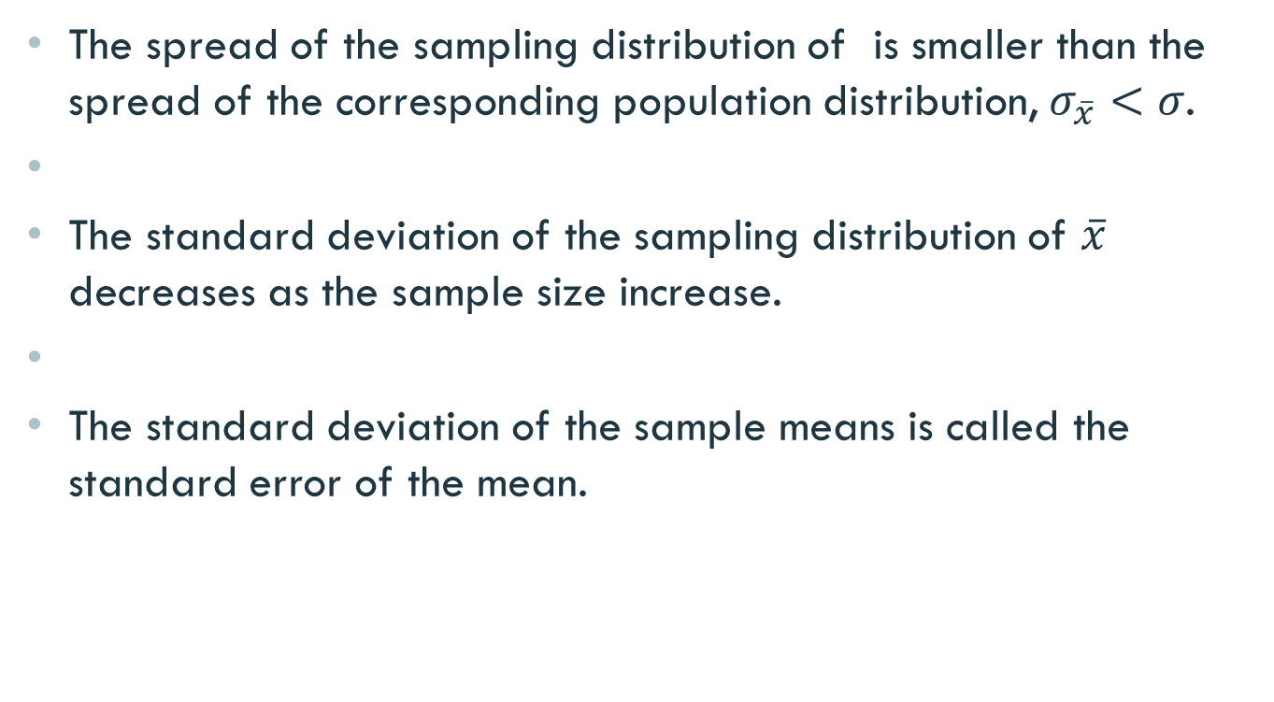
Properties of Sampling Distribution
The spread of the sampling distribution of is smaller than the spread of the corresponding population distribution, $σ_{\overline{x}}<σ$.
The standard deviation of the sampling distribution of $\overline{x}$ decreases as the sample size increase.
The standard deviation of the sample means is called the standard error of the mean.

Slide 17

Shape of the Sampling Distribution
The shape of the sampling distribution of $\overline{x}$ relates to the following two cases:
The population from which samples are drawn has a normal distribution.
The population from which samples are drawn does not have a normal distribution.

Slide 18
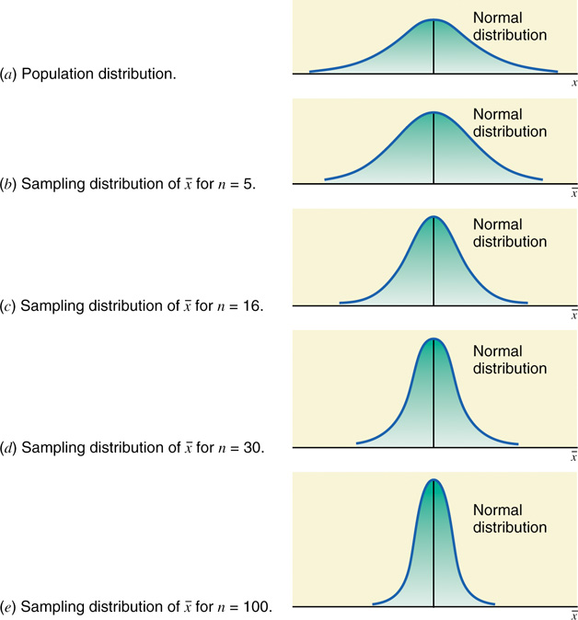
Population is Normally Distributed

Slide 19
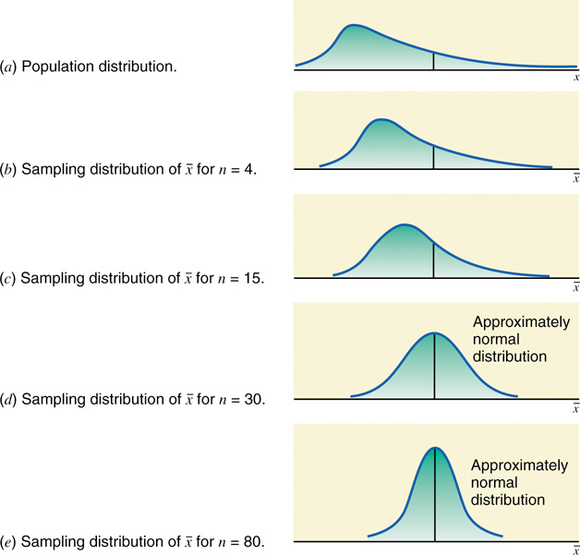
Population is Not Normally Distributed

Slide 20
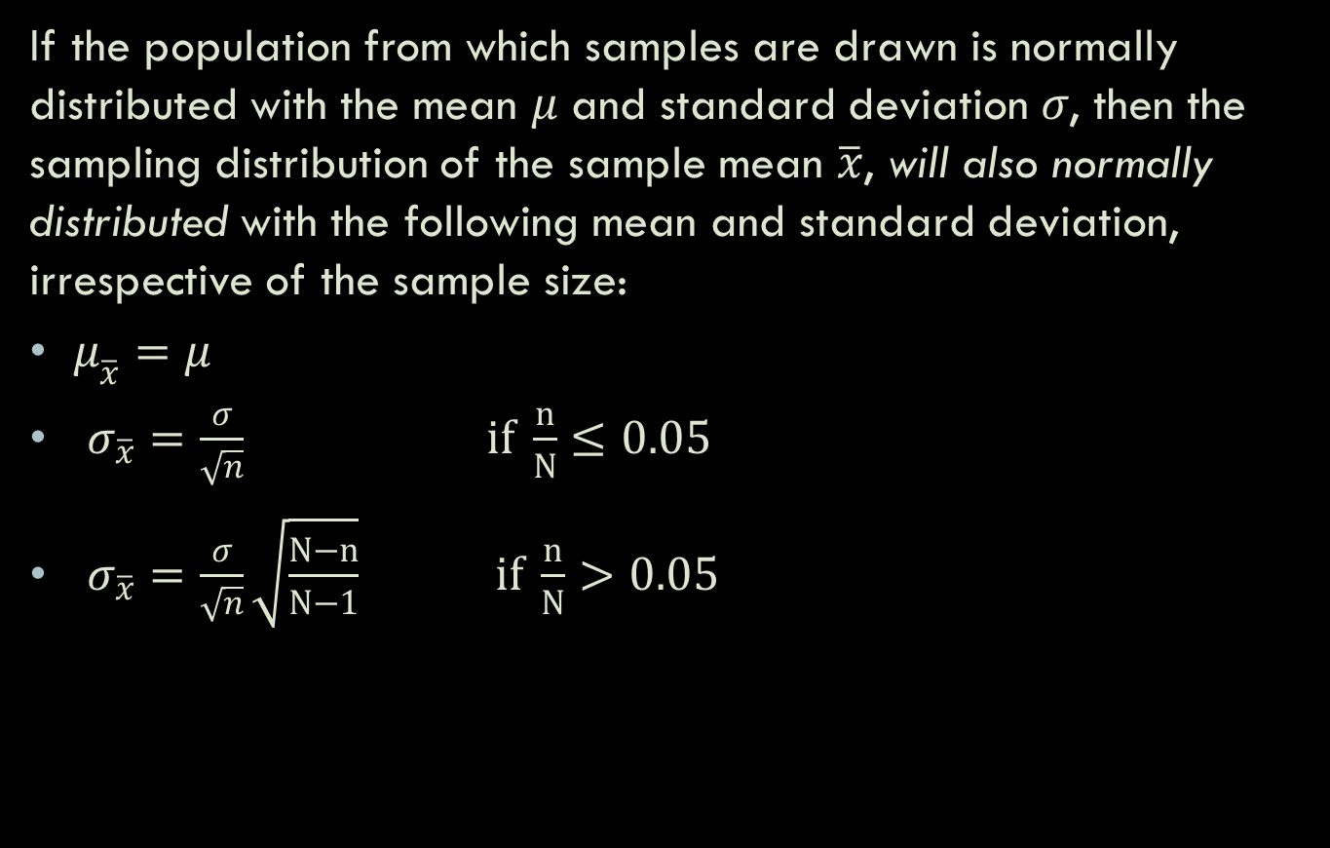
Sampling from a Normally Distributed Population
If the population from which samples are drawn is normally distributed with the mean $μ$ and standard deviation $σ$, then the sampling distribution of the sample mean $\overline{x}$, will also normally distributed with the following mean and standard deviation, irrespective of the sample size:
$μ_{\overline{x}}=μ$
$σ_{\overline{x}}=\frac{σ}{\sqrt{n}} if \frac{n}{N}≤0.05$
$σ_{\overline{x}}=\frac{σ}{\sqrt{n}}\sqrt{\frac{N−n}{N−1}} if \frac{n}{N}>0.05$

Slide 21
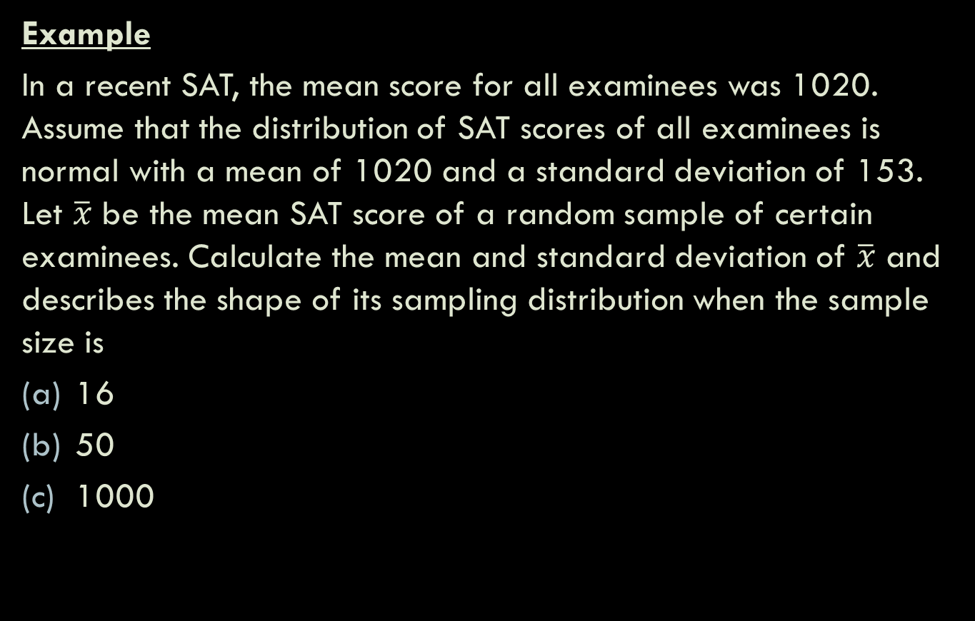
Sampling from a Normally Distributed Population
Example
In a recent SAT, the mean score for all examinees was 1020. Assume that the distribution of SAT scores of all examinees is normal with a mean of 1020 and a standard deviation of 153. Let $\overline{x}$ be the mean SAT score of a random sample of certain examinees. Calculate the mean and standard deviation of $\overline{x}$ and describes the shape of its sampling distribution when the sample size is
16
50
1000

Slide 22


$μ=1020 σ=153$
$$a. n=16$$
$$μ_{\overline{x}}=1020$$
$\frac{n}{N}=\frac{16}{N }<0.05$ (assumption)
$σ_{\overline{x}}$=$\frac{σ}{\sqrt{n}}$=$\frac{153}{\sqrt{16}}$=38.25

Slide 23
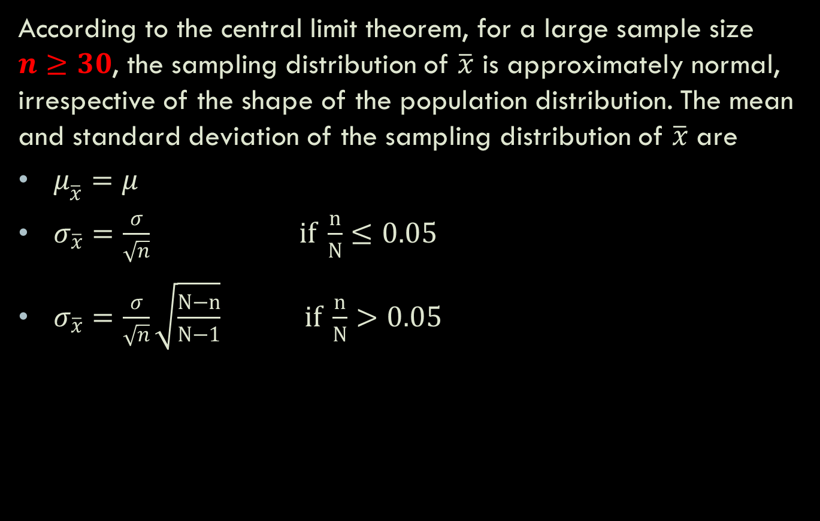
Sampling from a Population That is Not Normally Distributed
According to the central limit theorem, for a large sample size $n≥30$, the sampling distribution of $\overline{x}$ is approximately normal, irrespective of the shape of the population distribution. The mean and standard deviation of the sampling distribution of $\overline{x}$ are
$μ_{\overline{x}}=μ$
$σ_{\overline{x}}=\frac{σ}{\sqrt{n}} if \frac{n}{N}≤0.05$
$σ_{\overline{x}}=\frac{σ}{\sqrt{n}}\sqrt{\frac{N−n}{N−1}} if \frac{n}{N}>0.05$

Slide 24
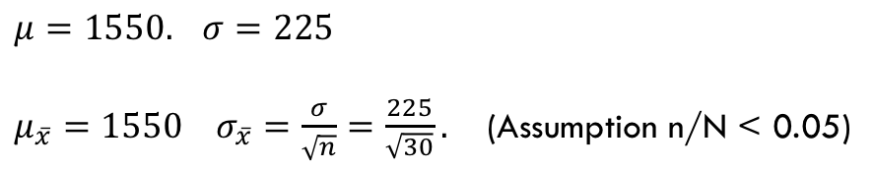
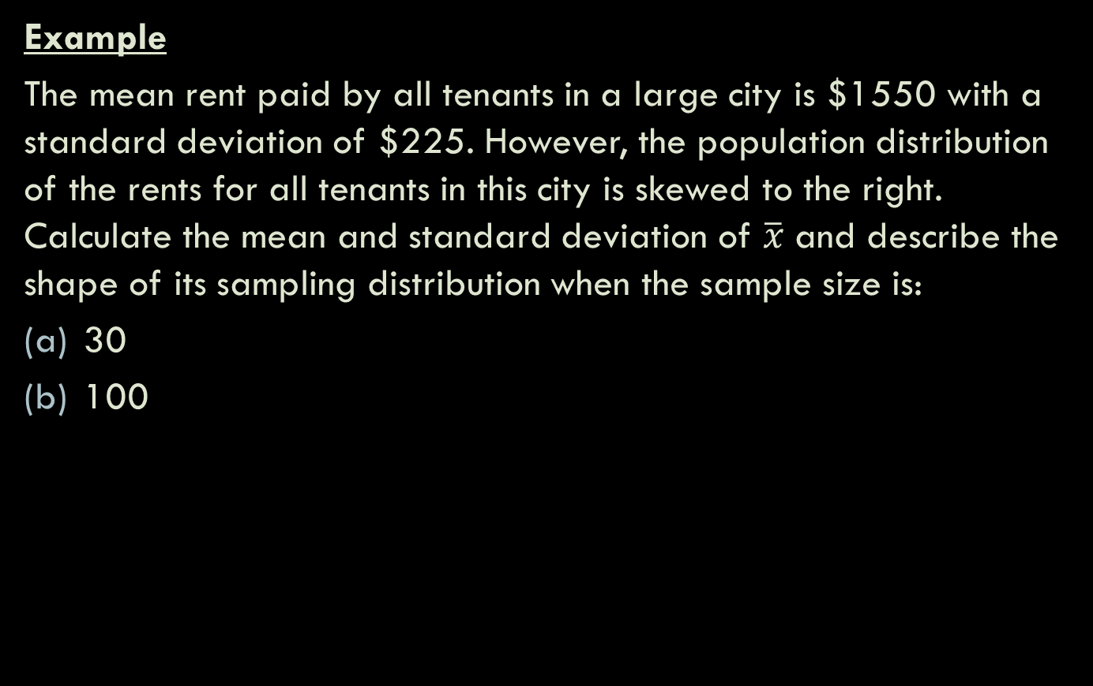
Sampling from a Population That is Not Normally Distributed
Example
The mean rent paid by all tenants in a large city is $1550 with a standard deviation of $225. However, the population distribution of the rents for all tenants in this city is skewed to the right. Calculate the mean and standard deviation of $\overline{x}$ and describe the shape of its sampling distribution when the sample size is:
30
100
$μ=1550.$ $σ=225$
$μ_{\overline{x}}=1550 σ_{\overline{x}}=\frac{σ}{\sqrt{n}}=\frac{225}{\sqrt{30}}.$ (Assumption n/N < 0.05)
The shape of the sampling distribution is approximately normal

Slide 25
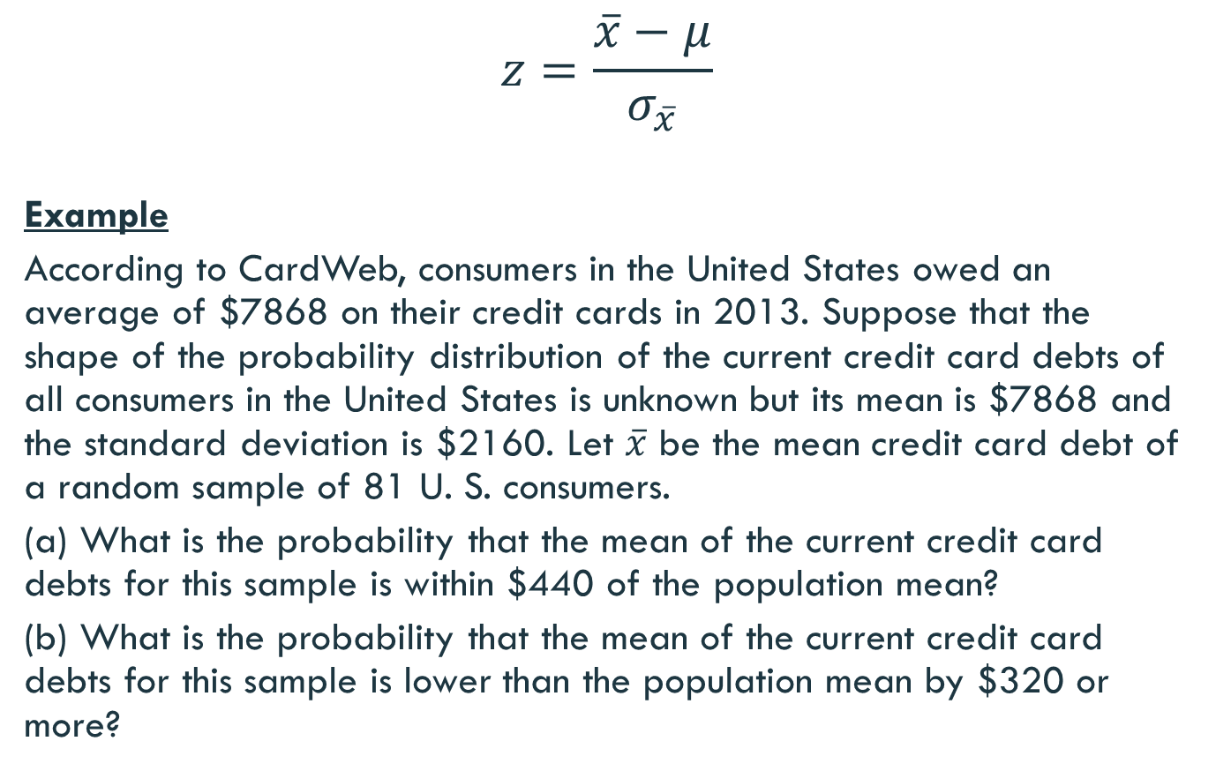

Z Value for a Value of $\overline{x}$
$$z=\frac{\overline{x}−μ}{σ_{\overline{x}}}$$
Example
According to CardWeb, consumers in the United States owed an average of $7868 on their credit cards in 2013. Suppose that the shape of the probability distribution of the current credit card debts of all consumers in the United States is unknown but its mean is $7868 and the standard deviation is $2160. Let $\overline{x}$ be the mean credit card debt of a random sample of 81 U. S. consumers.
(a) What is the probability that the mean of the current credit card debts for this sample is within $440 of the population mean?
(b) What is the probability that the mean of the current credit card debts for this sample is lower than the population mean by $320 or more?

Slide 26
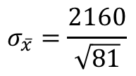
P(7868-440<x<7868+440)=P(7428<x< 8308)
$$σ_{\overline{x}}=\frac{2160}{\sqrt{81}}$$

Slide 27
Example
Assume that the weights of all packages of a certain brand of cookies are normally distributed with a mean of 32 ounces and a standard deviation of 0.3 ounce. Find the probability that the mean weight, of a random sample of 20 packages of this brand of cookies will be between 31.8 and 31.9 ounces.

Slide 28
the shape of the sampling distribution of is normal because the population is normally distributed.

Slide 29
Example
In a study of the life expectancy of 500 people in a certain geographic region, the mean age at death was 72 years and the standard deviation was 5.3 years. If a sample of 50 people from this region is selected, find the probability that the mean life expectancy will be less than 70 years.

Slide 30
➔ need correction factor

